Slide 1
Project team:
UWIMBABAZI Aimee Patience 220005117
NIYOGISUBIZO Thierry 220015546

Slide 2
PATNIZO HOTELS
MULTI-HOTEL MANAGEMENT SYSTEM

Slide 3

The Idea

Slide 4
Introduction
Patnizo hotels is a multi-hotel management system that manages many different hotels starting from Patnizo Hotel as the main hotel.
This project is all about of managing more than one hotel under the same control which Means there is many hotels that works under same rules, same style of working as well as same philosophy .

Slide 5
Problem statement
From observation study, we found that there is very large scale of disorganization and miss Management in hotels which are owned by individuals , there by we came with an idea of building a centralized platform for coordinating those different platforms, so they can be easily controlled and managed to achieve sameness and uniformity.

Slide 6
Why patnizo??
From the problem statement, there appear idea for designing system to manage many hotels as single one.
This platform will help multi-hotel owner in management of all Hotels Information such as Clients, Hotels Activities, and employees Management.
It will also be like a heaven platform for clients as they will be able to access multiple hotels information at once, and it will assure clients that even if at different locations he will be going to receive same service as hotels will be working under same management.

Slide 7
objectives
After implementation of Patnizo Hotels Management System, we expect many
different hotels management issues to be solved like:
• Centralized Maintenance of all our customers information
• Simplify work of management for hotels
• Coordinated hotels activities
• Uniformity and sameness of hotels

Slide 8
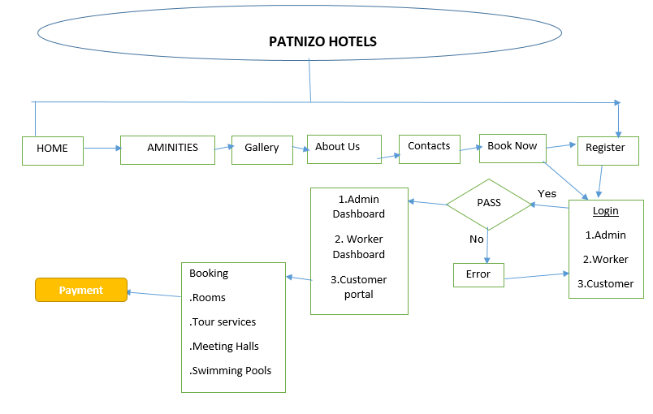
FUNCTIONALITIES

Slide 9
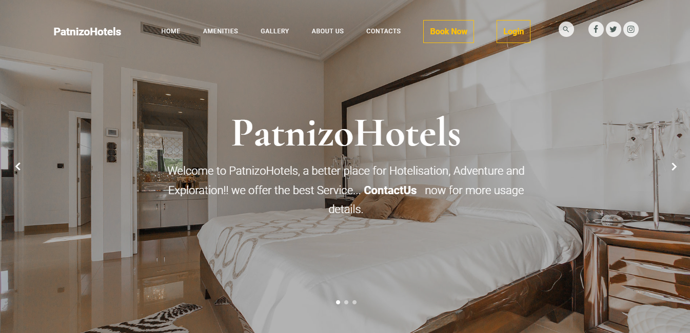
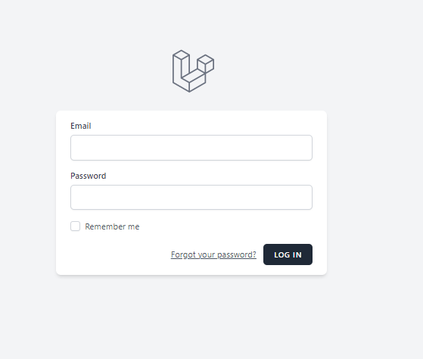
login: there are three users which are worker, Admin and Viewer as customer. So according to the credentials entered you will be redirected to the dashboard page.

Slide 10
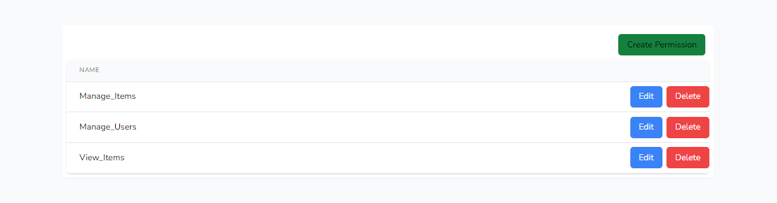
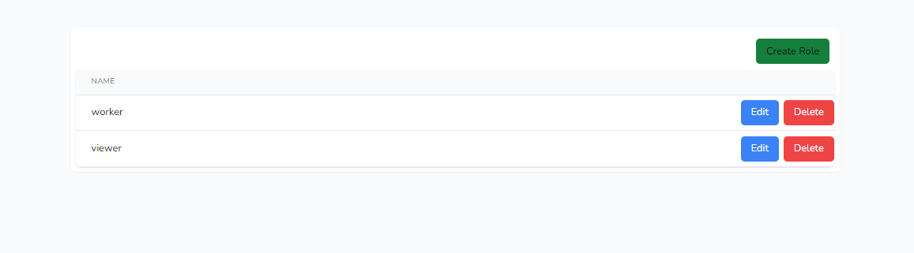
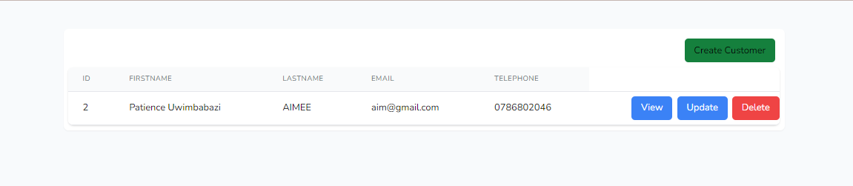
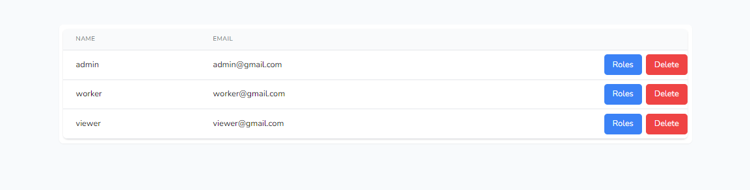
Admin dashboard

Slide 11
Technologies Used
Tailwind CSS and Bootstrap for design
MySQL database
Laravel spatie for permissions and roles
HTML and JavaScript

Slide 12
Conclusion
By this system we are sure that the hotel will be well managed, and as we know a key of achieving success is to assemble a strong and stable management. From this customers will receive good customer care, and this will be profitable to them , hotels and society in general. Even though there is still much work to be done on this project but we are sure that it will solve a huge problem.

